Slide 1
The Geographic Distribution of Accessible Medicaid Participating Primary Care Offices in LA County
Mary Lou Breslin, M.A.
Nancy R. Mudrick, M.S.W., Ph.D
Kyrian Nielsen, M.S.W.
3075 Adeline Street, Suite 210 • Berkeley, CA 94703 • 510.644.2555 • 510.841.8645 fax/tty
www.dredf.org

Slide 2
Acknowledgements
We would like to thank the organizations that have supported this work.
Pacific ADA Center
WITH Foundation
True North Foundation
We also wish to acknowledge June Kailes and Brenda Premo, whose work with California Medicaid Managed Care plans more than a decade ago was instrumental in the development of the data collection process and the data we present.

Slide 3
Presentation Overview
Part I
Why does accessibility and geographic location matter?
Review research and data documenting access barriers
Describe legal requirements for health care setting access
Part II
Describe a feasible method for measuring primary care office accessibility across a region
Present a tool based upon ADA architectural standards to assess accessibility
Show use of geographic and census data to evaluate the match of accessible offices to number of potential users
Provide an example of data analysis combining access characteristics and geographic location
Part III
Policy applications for these methods and analyses

Slide 4
Learning Objectives
We would like you take away from this presentation—
An understanding of the potential impact of the geographic distribution of accessible doctors’ offices on health care for people with disabilities
Knowledge of a method for measuring primary care office accessibility

Slide 5
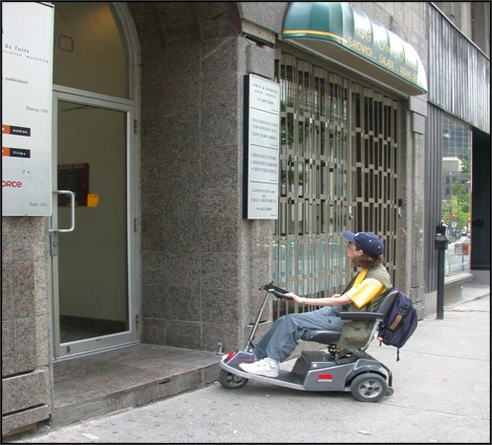
Part I
Why does accessibility and geographic location matter?
The research and data documenting access barriers
The bases of legal requirements for health care setting access

Slide 6
Why does accessibility and its geographic location matter?
Health disparities are connected to access barriers
Physical barriers and inaccessible examination equipment contribute to health disparities because they result in inferior care, delayed care, or refused care
Access is not equal if there are few choices
If a patient is required to travel a great distance to an accessible health care setting, that patient may delay care or “settle” for a proximate but inferior care experience

Slide 7
Patients report inferior care or refusal to accept as a patient due to an inaccessible primary care office

Slide 8
Titles II and III of the ADA apply to medical care providers
Both titles require—
Full and equal access to their health care services and facilities
Reasonable modifications to policies, practices, and procedures when necessary to make health care services fully available to individuals with disabilities, unless the modifications would fundamentally alter the nature of the services (i.e. alter the essential nature of the services).

Slide 9
Legal and Regulatory Links to Physical Access Requirements
ADA Title II: Non-discrimination in health care applies to
“a public entity, in providing aid, benefit, or service,… directly or through contractual, licensing, or other arrangements” (28 CFR § 35.130(b)(1))
ADA Title III: Private health care providers are defined as public accommodations (28 CFR 36.104 (1))
A public accommodation is required to remove architectural and communication barriers to equal access and treatment in health care when removal is readily achievable
Medicaid regulations 2016 (42 CFR 438) require states ensure that Medicaid managed care plans offer
accessibility of network provider offices/facilities and network adequacy standards that consider physical access and accessible equipment

Slide 10
Challenges to Monitoring Health Care Office Accessibility
There is no national database. We do not know whether all, most, or few primary care offices are prepared to provide care to people with disabilities
Most prior research on primary care access is based upon small sample sizes in a single geographic area, or asked practices to voluntarily self-administer the audit tool
Some efforts involve having the patient bring the tool and conduct the audit, which may burden the patient or create awkwardness between patient and provider
The ACA had a provision, never implemented (now sunsetted), to require data collection about the preparation of health care settings to provide care to people with disabilities
The 2016 Medicaid Managed Care regulations were issued, but have not been fully implemented

Slide 11
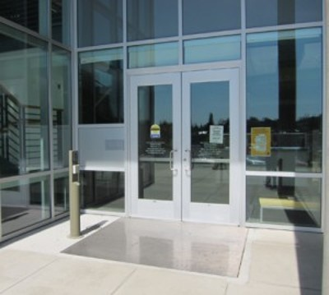
Part II
Methods for conducting an access audit
Combining audit data with geographically located census data
Examples of data analysis with LA County as a case study

Slide 12
California Access Audit: Overview
Accessibility audits began as voluntary add-ons to state-mandated on-site reviews of Medicaid Managed Care primary care offices in California
Managed Care Plans worked with June Kailes and Brenda Premo to develop the tool and train auditors on its use. Then it was appended to the state-required review
Data are collected by a walk-through of primary care physician offices
Trained managed care plan staff conduct the audits using a structured form
California now mandates the audit when a primary care office joins a Medicaid managed care plan, and every 3 years thereafter
Each plan holds the data it collects; plans share data so that a single site is not subjected to multiple reviews

Slide 13
“Provider Facility Site Review Accessibility Tool for Seniors and Persons with Disabilities,” 2011
Part of the California Department of Health Care Services facility site review form and process
The 86-item 2011 audit instrument is comprised of 80 physical access elements derived from the ADAAG (ADA Accessibility Guidelines) 2010 revision
6 questions about equipment presence and characteristics
The tool requires measurement of door widths, ramp angles, and turning radii, as well as observation of interior and exterior elements

Slide 14
Summary of the Accessibility Elements
Element category | # of Elements
Parking. Accessible spaces, width, signage, curbs, route to building, van spaces | 13
Exterior route from parking, transport, and sidewalk. Curbs, path width, surface quality, ramps, ramp leg length | 10
Building entrance. Door width and swing, signage to accessible entrance, handles | 8
Interior route and office interior. Non-stair clear path, floor surfaces, lighting, stair characteristics, door weight, waiting area, sign-in, signage, patient controls, alarms | 20
Elevators. Audible, visible controls, signage, turning radius, emergency call system | 10
Toilet rooms with and without stalls. Turning radius, grab bars, faucet handles, sink characteristics, door weight | 18
Examination rooms and exam equipment. Interior spacing, height adjustable table, accessible scale, patient lift | 7

Slide 15
Example of audit tool elements for bathroom sinks and faucets

Slide 16
Example of audit tool elements for height adjustable exam tables

Slide 17
Data Analysis of Site Review Audits
In 2017 we requested the site review data for 2013-2016 from the California Medicaid Managed Care plans
Five plans sent data, including the two plans that serve Los Angeles County, comprising a total of 3993 primary care offices
LA County audit data covered 2096 physician offices (practices)
The only identifying information provided was Zip code (no names or addresses)
The data were merged into a single dataset and any duplicates were removed
The next slide summarizes findings for interior office elements that are most often problematic, toilet rooms and examination equipment

Slide 18
Summary of accessible physician office elements LA County
Office element present across managed care providers | % of practices (n=2096)
Height-adjustable examination table | 14.9%
Accessible weight scale | 8.6%
Patient lift to assist with transfers | 3.7%
70% - 100% of toilet room features meeting accessibility standards | 49.0%
At least one office within the zip code has the element present | % of zip codes (n=233)
Height-adjustable examination table | 47.3%
Accessible weight scale | 31.0%
Patient lift to assist with transfers | 15.9%
70 – 100% of toilet room features meeting accessibility standards | 26.6%

Slide 19
Geographic mapping of LA County accessible offices
With ArcGIS software we mapped the facility audit information by the zip code in which the medical practice is located
We placed within each zip code the number of medical practices with at least one accessible exam table, with similar maps for scales and for lifts
The number of people reporting a mobility impairment by zip code was downloaded from the 2016 American Community Survey and grouped into 3 categories: 0-2000, 2001-4000, and 4001 and above
Zip codes on the map were color coded by these categories; yellow, orange, red from lowest to highest population numbers
A 10 square mile grid is laid over the map to provide an indication of the distances

Slide 20
Practices with Height Adjustable Exam Tables
Color key: Number of persons with mobility impairment
Yellow: 0 - 2000
Orange: 2001 - 4000
Red: >4000
Grey: No population data
Numbers within the black circles are the number of primary care practices within that zip code that have a height adjustable examination table.
Grid lines = 10 sq. miles
Breslin, Mudrick, Nielsen, 2020.
Do not copy without permission

Slide 21
Practices with Accessible Scales
Color key: Number of persons with mobility impairment
Yellow: 0 - 2000
Orange: 2001 - 4000
Red: >4000
Grey: No population data
Numbers within the black circles are the number of primary care practices within that zip code that have accessible scales.​
​
Grid lines = 10 sq. miles
Breslin, Mudrick, Nielsen, 2020.
Do not copy without permission

Slide 22
Practices with Patient Lifts
Color key: Number of persons with mobility impairment
Yellow: 0 - 2000
Orange: 2001 - 4000
Red: >4000
Grey: No population data
Numbers within the black circles are the number of primary care practices within that zip code that have patient lifts.​
​
Grid lines = 10 sq. miles
Breslin, Mudrick, Nielsen, 2020.
Do not copy without permission

Slide 23
Zip Code Highlights
93550
Palmdale
91767
North Pomona
90007 Los Angeles
90201 Bell Gardens

Slide 24
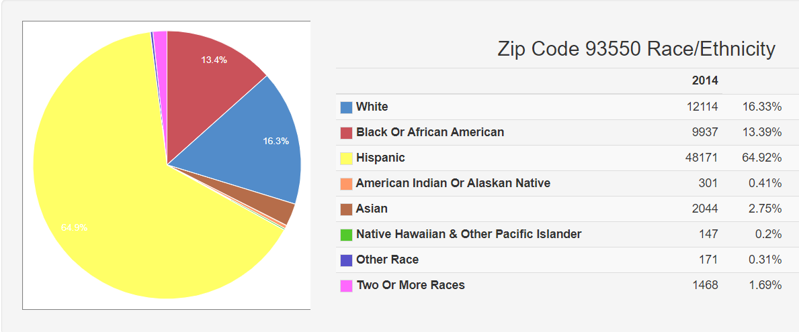
Selected zip code detail: 93550 Palmdale, CA
Total Population: 74,929 4,855 people with a mobility impairment (7.2%)
 | Exam Tables | Lifts | Scales
Number of Providers with-- | 0 | 0 | 0
Number of people per provider with-- | NA | NA | NA
Median household income: $38,316, Poverty rate: 32.3%

Slide 25
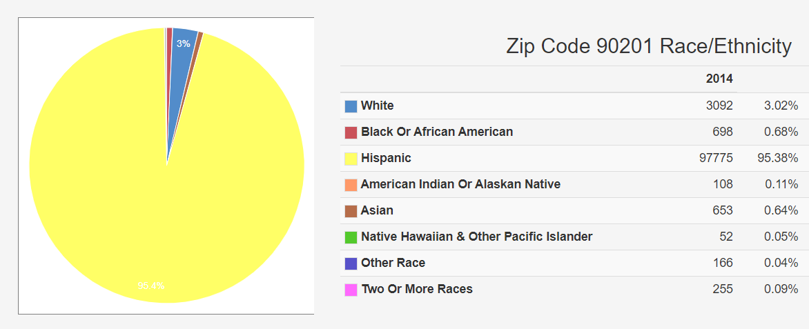
Selected zip code detail: 90201 Bell Gardens, CA
Total Population: 101,279 4,228 people with a mobility impairment(4.5%)
 | Exam Tables | Lifts | Scales
Number of Providers with-- | 6 | 1 | 5
Number of people per provider with-- | 704.7 | 4,228 | 845.6
Median household income: $37,267, Poverty rate: 28.2%
Median household income: $37,267, Poverty rate: 28.2%

Slide 26
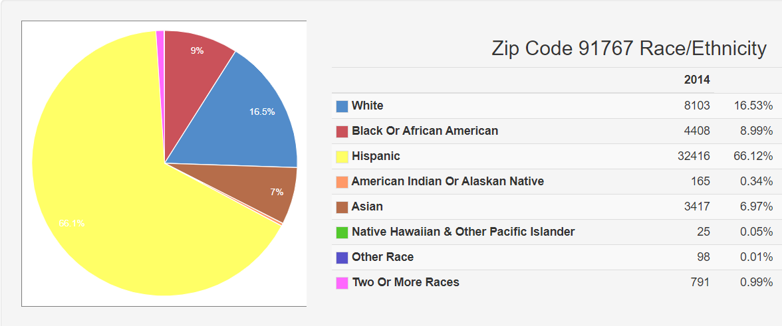
Selected zip code detail: 91767 North Pomona, CA
Total population: 48,068 2,924 People with a mobility impairment (6.4%)
 | Exam Tables | Lifts | Scales
Number of Providers with-- | 10 | 4 | 4
Number of people per provider with-- | 292.4 | 731 | 731
Median household income: $49,881, Poverty rate: 20.5%

Slide 27
Selected zip code detail: 90007 Los Angeles, CA
Total population: 40,920 2,028 People with a mobility impairment (5%)
 | Exam Tables | Lifts | Scales
Number of Providers with-- | 2 | 0 | 1
Number of people per provider with-- | 1,014 | NA | 2,028
Median Household Income: $22,420, Poverty rate: 48.5%

Slide 28
Key Insights from Mapping Accessible Offices
Medicaid participants with mobility impairments in the northern geographically large zip codes do not have medical practices with accessible equipment nearby
Many practices in the dense urban area lack accessible equipment, although travel to an accessible practice may be more feasible
The number of people with mobility impairments per practice with accessible equipment implies that patients may have only one or two nearby choices; choice may be reduced if the nearby provider with equipment does not belong to the patient’s Medicaid plan
The profiles of the highlighted zip codes raise questions regarding whether, among Medicaid participants, there are ethnic and racial disparities in the accessibility characteristics of the medical practices most likely to serve them—with greater implications for the quality of care received

Slide 29
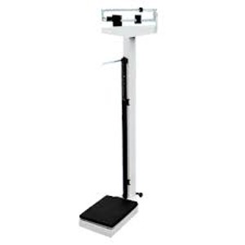
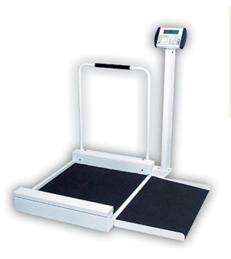
Part III
The measurement of medical care access in the context of larger health policy

Slide 30
I. What is Happening Across US
Federal agencies increasing involvement and role with states and plans
Medicare
Medicaid/Medicaid dually eligible LTSS contracts
Equity concerns
Community partnerships between Medicaid managed care organizations and disability services and advocacy groups
Academic centers turning attention to health care access barriers research
Legal actions

Slide 31
II. What is Happening Across US
ADA hospital system litigation increasing access (2001-present)
California physical access audit extended to specialty and ancillary service providers, that serve a high volume of seniors and persons with disabilities (2012)
HHS/CMS, Office of Minority Health: Equity Plan for Improving Quality of Medicare: Increase physical accessibility of health care facilities (Sept. 2015)

Slide 32
III. What is Happening Across US
CMS Medicare-Medicaid Coordination Office: Disability Competent Care Self-Assessment Tool (Physical Accessibility)—Resources for Plans and Providers for Medicare-Medicaid Integration (2017)
HHS/CMS Brief: Increasing the Physical Accessibility of Health Care Facilities (2017)
Managed LTSS contracts: Key accessibility requirements as of 2017
On site accessibility reviews; use of specific surveys
Designated responsible person
Reasonable accommodation, policy modification, auxiliary aids and services

Slide 33
IV. What is Happening Across US
Centene Health Plan partners with National Council on Independent Living
Providers nationwide self-report accessibility using CA audit tool; verified by IL Centers
Barrier removal fund
52 health care providers receive $470,000 in grants (2018)
Centene receives CMS Health Equity Award
CMS Office of Minority Health: Improving Access to Care for People with Disabilities – videos, patient guide, 'Resources Inventory' (2020)

Slide 34
In the Future
National standardized access audit
Enhanced Role for Medicaid Managed Care Plans
Proactive Role in auditing accessibility of provider offices, including equipment
Incentivizing access modifications if needed; pay for procurement of accessible equipment for high use providers
Team with local advocacy organizations on training

Slide 35
Summary Points
It is possible to audit a large number of primary care offices; the California method is replicable
Audits produce information that is useful to providers and patients
A geographic look can help target priorities for action
Knowing the density of accessible care sites does not relieve every provider of ADA obligations; patients must also be able to choose their provider
CMS and other federal agencies have a role in monitoring, facilitating and enforcing physical access to health care facilities
Attention to physical and programmatic accessibility of health care facilities is increasing with public and private efforts; however, monitoring for progress is required

Slide 36
Resources for More Information
Mudrick, N.R., Swager, L.C., and Breslin, M.L. (2019). Presence of accessible equipment and interior elements in primary care offices, Health Equity, 3(1): 275-279. Mudrick Swager Breslin 2019 Accessible interior offices
Improving Access to Care for People with Disabilities CMS Improving access to care for people with disabilities
Modernizing Health Care to Improve Physical Accessibility—Resources Inventory CMS Modernizing health care physical accessibility resource inventory
Increasing the Physical Accessibility of Health Care Facilities CMS Increasing the physical accessibility of health care facilities
Consent Decree, Olson v. Sutter Health (2008) Consent decree Olson v Sutter Health

Slide 37
Resources for More Information (continued)
Medicaid and CHIP Managed Care Final Rule Medicaid and CHIP managed care final rule
Equal access to care: "Core Competencies on Disability for Health Care Education," Ohio State University, Nisonger Center. Core competencies on disability for health care education OSU Nisonger Core competencies on disability for health care post-consensus OSU Nisonger
CMS Medicare-Medicaid Coordination Office. Disability Competent Care Self-Assessment Tool CMS Disability competent care self-assessment tool
Promoting Physical and Programmatic Accessibility in Managed Long-Term Services and Supports Programs. DREDF Promoting physical and programmatic accessibility in LTSS
Increasing Visibility, Transparency, and Access through the Provider Accessibility Initiative Centene Increasing access through provider accessibility initiative

Slide 38
Contact Information
Mary Lou Breslin
mlbreslin@dredf.org
Disability Rights Education and Defense Fund (DREDF)
Ed Roberts Campus
3075 Adeline Street, Suite 210
Berkeley, CA 94703
510.644.2555
fax 510.841.8645
Follow us on Twitter @DREDF
On facebook.com/DREDF.org
www.DREDF.org
Nancy R. Mudrick Kyrian Nielsen
mudrick@syr.edu kanielse@syr.edu
School of Social Work
244 White Hall, Falk Complex
Syracuse University
Syracuse, NY 13244
socialwork.syr.edu

